Slide 1



Home
About
Contact
Supply chain Analysis
01
02
Start Slide
03
2025 Presentation

Slide 2


Home
About
Contact
Content
Introduction
Data Preparation Process
Executive Summary of the Dashboard
Dashboard Detailed Overview
Recommendations&Conclusion
01
02
03

Slide 3
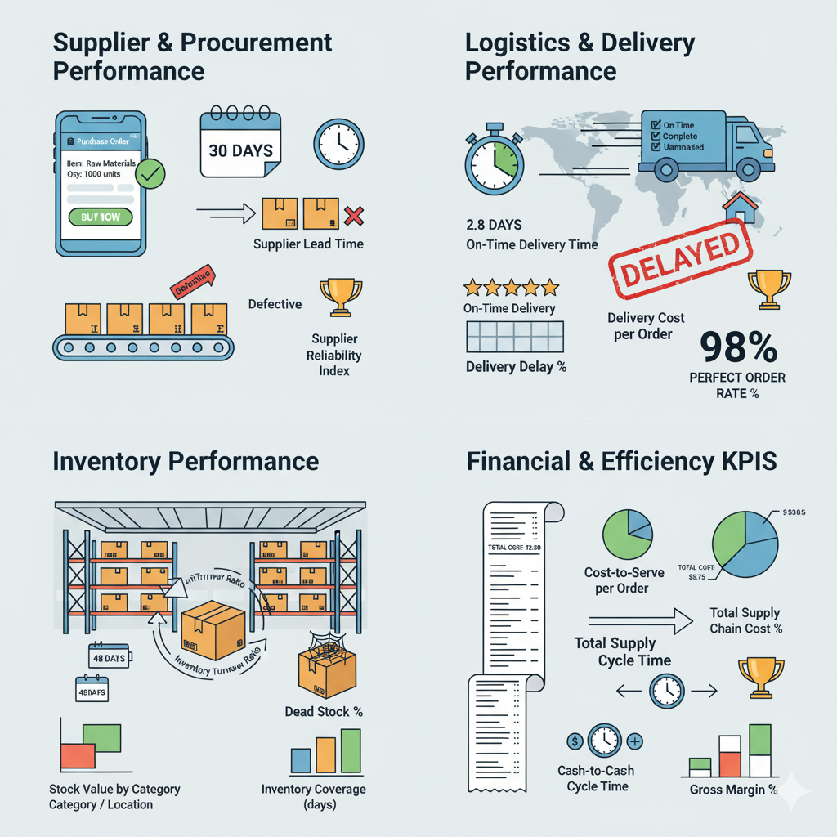
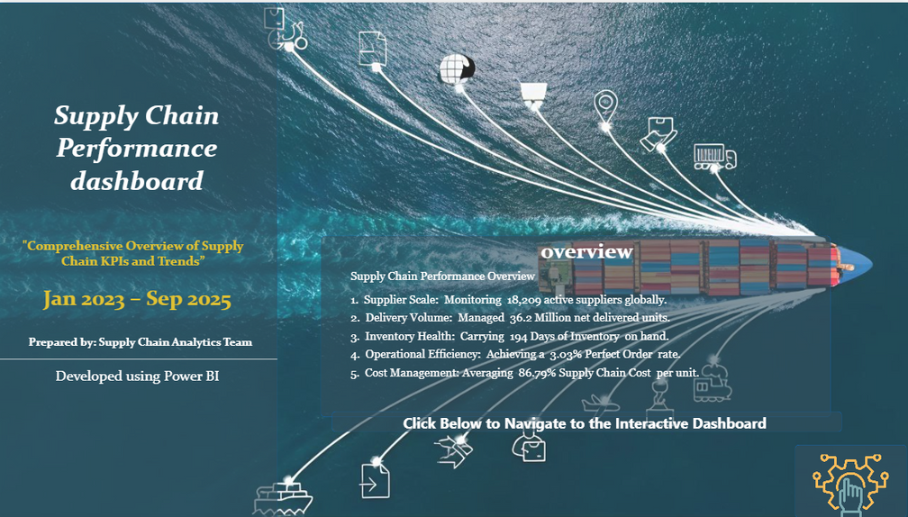
Avery Davis
Home
About
Contact
Introduction
01
This project analyses the company’s supply chain using data exported from multiple ERP modules. The datasets were integrated, cleaned, and modelled to create an analytical environment suitable for KPI tracking and performance assessment.
02
Learn More
03

Slide 4
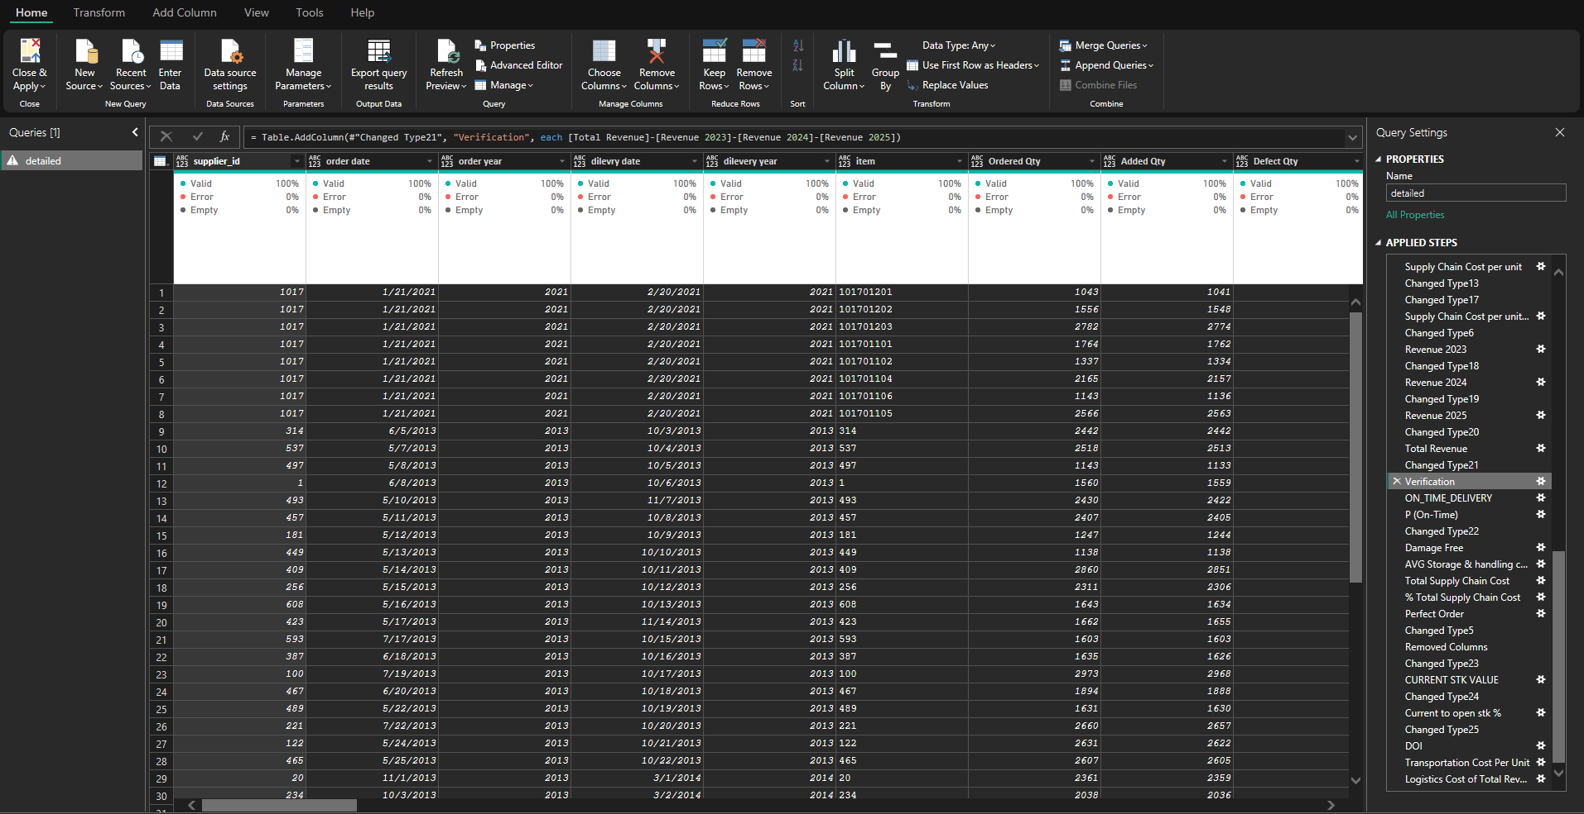
Data Preparation Process
Cleaning :
Removed duplicates and null entries.
Standardised naming conventions and fixed inconsistent numerical values.
Verified all financial values for consistency
Transformation:
Created 42 calculated columns
Created 25 DAX measures (e.g., Net Profit, Total
Cost, Defect Rate, Returned Quantity %, Lead Time Classification).

Slide 5
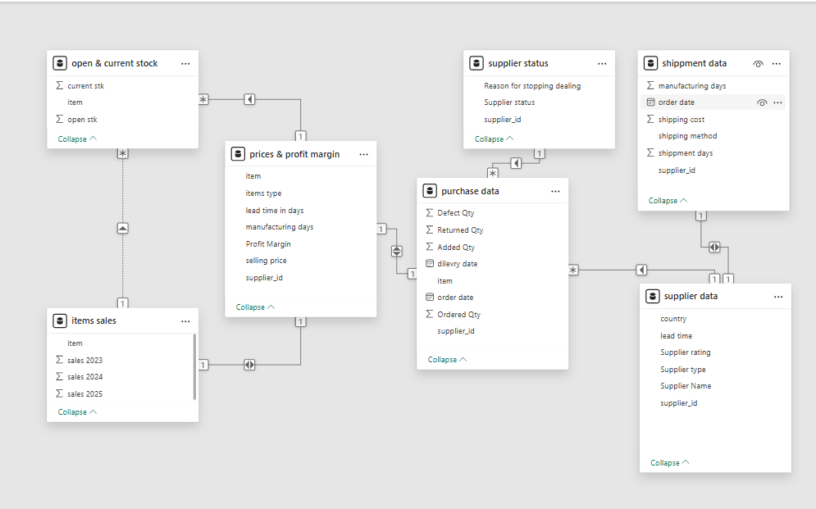
Data Modelling
1. Supplier Data
Acts as the central dimension table.
Contains supplier attributes (country, rating, type, lead time).
Connected to all fact tables using supplier_id.
2. Prices & Profit Margin
Includes item-level pricing, profit margin, and manufacturing lead time.
Links product financial performance with supplier information.
3. Items Sales
Stores annual sales quantities (2023–2025).
Joined with item details to analyze item performance over time.
4. Open & Current Stock
Shows current and opening stock levels.
Helps calculate stock turnover, availability, and supply planning metrics.
5. Purchase Data
Includes ordered quantities, returned/defect items, and delivery dates.
Enables monitoring of supplier reliability, delays, and quality issues.
6. Shipment Data
Contains shipping costs, shipping method, shipment days, and order dates.
Used to evaluate logistics efficiency and total landed cost.
7. Supplier Status
Tracks supplier performance status and reasons for stopping dealings.
Useful for risk assessment and supplier lifecycle management.
snowflake schema

Slide 6
Home
About
Contact
Executive Summary
The supply chain performance analysis reveals several areas of strength and significant opportunities for improvement:
Strengths:
Strong Supplier Base: Over 751 suppliers, with a majority rated 3–5.
High Delivery Volumes: Over 36.5 million units delivered across categories like bathroom, commercial lighting, and decor.
Cost Efficiency: Low average cost-to-serve for local and consumables suppliers ($1.2K and $1.5K per order).
Concerns:
Lead Time Variability: Average lead time is 60+ days, with some suppliers exceeding 90 days.
Low Perfect Order Rate: Only 17% of orders are classified as “perfect,” raising a concern in fulfilment accuracy.
High Supply Chain Cost: Supply chain cost per unit is 86.79%, indicating inefficiencies in logistics and handling.
Excess Inventory: Days of Inventory (DOI) is 194 days, with an average stock coverage of 15 months, suggesting overstocking.
Delivery Delays: On-time delivery rate is excellent, with delay rates impacting 34 orders only.
Financial & Operational Impact:
High defect and return rates in categories like bathroom and commercial lighting.
Forecast inaccuracy with significant variance between actual and forecasted sales.
Dead stock percentage not tracked, posing a risk of obsolescence.

Slide 7
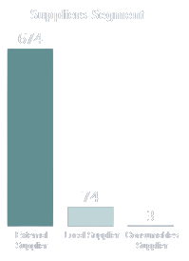
Home
About
Contact
Supplier Performance Overview
Objective of supplier analysis
Why supplier performance is critical to supply chain efficiency
Overview of data used (2023–2025)
Mention the KPIs covered across the two pages!!

Slide 8
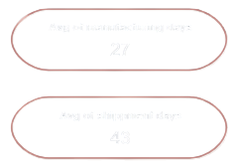
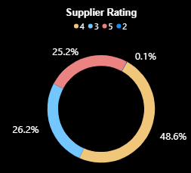
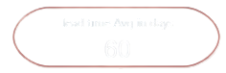
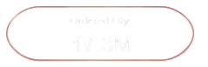
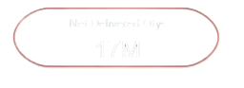
Home
About
Contact
Supplier Operational Performance
Distribution of suppliers (count, type: local vs external)
Average lead time, manufacturing days, shipment days
Ordered vs Net Delivered quantities
Supplier rating distribution
Quality indicators (defect qty, return qty)

Slide 9
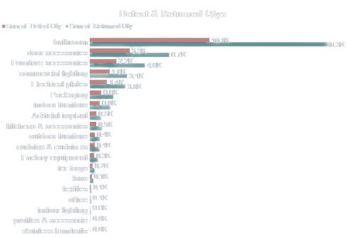
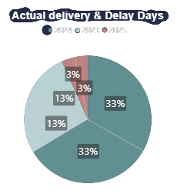
Home
About
Contact
Supplier Performance Trends (Yearly & Type-Based)
Lead time trends by supplier type (Is external slower?)
Delay days vs actual delivery days by year
Yearly net delivered quantities
Quality loss indicators (defect + return per item type)

Slide 10
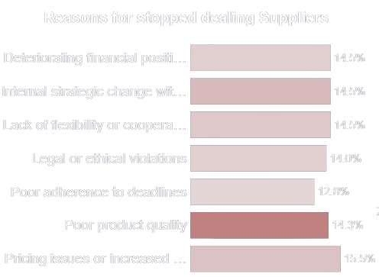
Home
About
Contact
Key Insights & Improvement Opportunities
Best vs worst performing supplier type
Main causes of delays
Categories contribute most to losses
Quality trends (defect/return)

Slide 11

Home
About
Contact
Inventory Performance Overview
Assessing storage efficiency, stock movement, and overall inventory health.
Covers period: 2023 – 2025.
KPIs include DOI, Dead Stock, Current/Open Stock %, and Stock Coverage

Slide 12
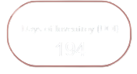
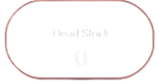
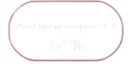
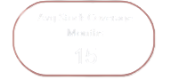
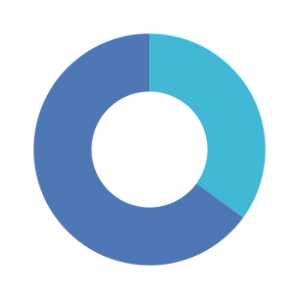
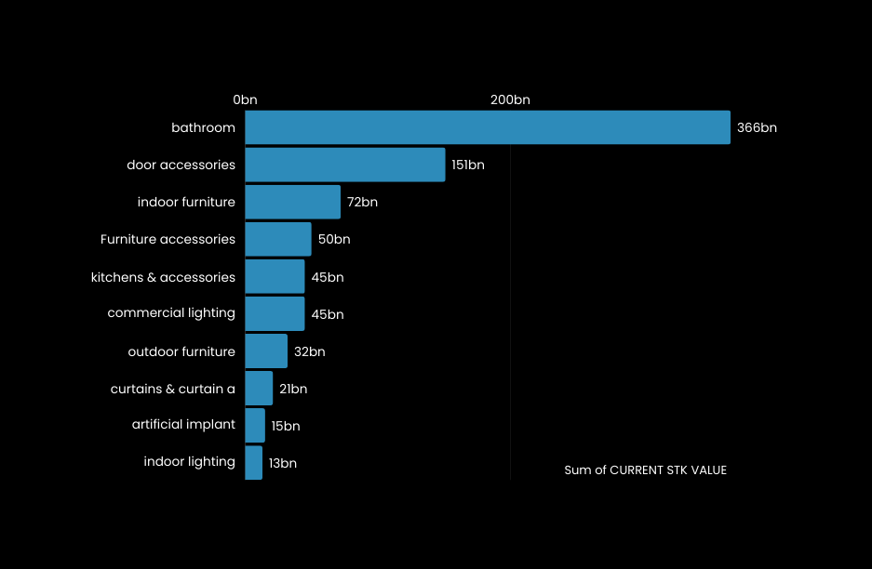
Home
About
Contact
Key Inventory KPIs & What They Indicate
Days of Inventory (DOI): 194 days – High, indicates slow movement.
Dead Stock: 0 – Strong indicator of efficient stock management.
Current to Open Stock Ratio: 54% – More than half of ordered items stocked.
Stock Coverage: 15 months – High coverage, suggests overstocking.
Open stock 65% vs current 35% → positive indication of future movement
Stock Value Distribution & Category Insights
Highest stock value categories:
Bathroom: 366 bn
Door Access: 151 bn
Indoor Furniture: 72 bn
Stock is concentrated in a few categories → risk of capital freeze.

Slide 13
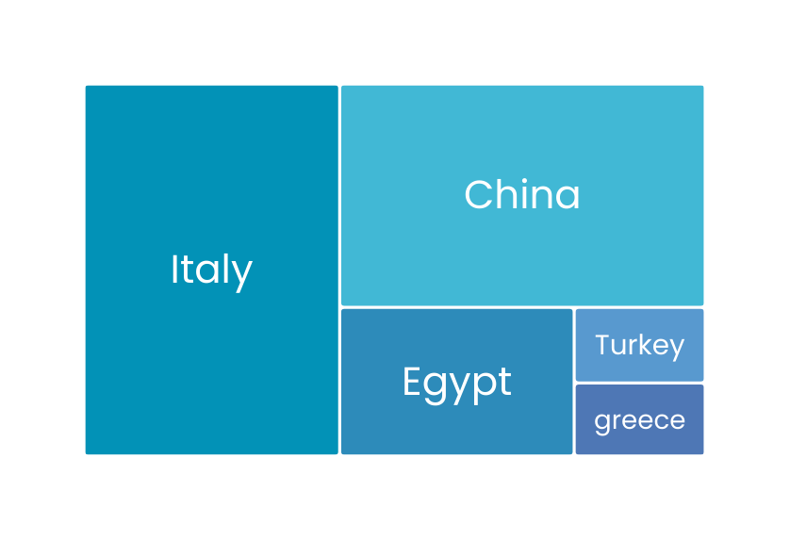
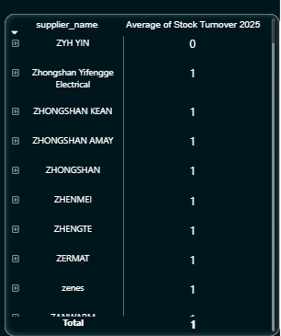
Home
About
Contact
Supplier Impact & Handling Cost Analysis
Handling costs highest from Itay, China, Egypt, Turkey.
Supplier turnover mostly = 1 → slow movement from supplier side.
Previously high purchase volumes caused inventory buildup.
Company now reducing purchases to lower stock and improve turnover.

Slide 14
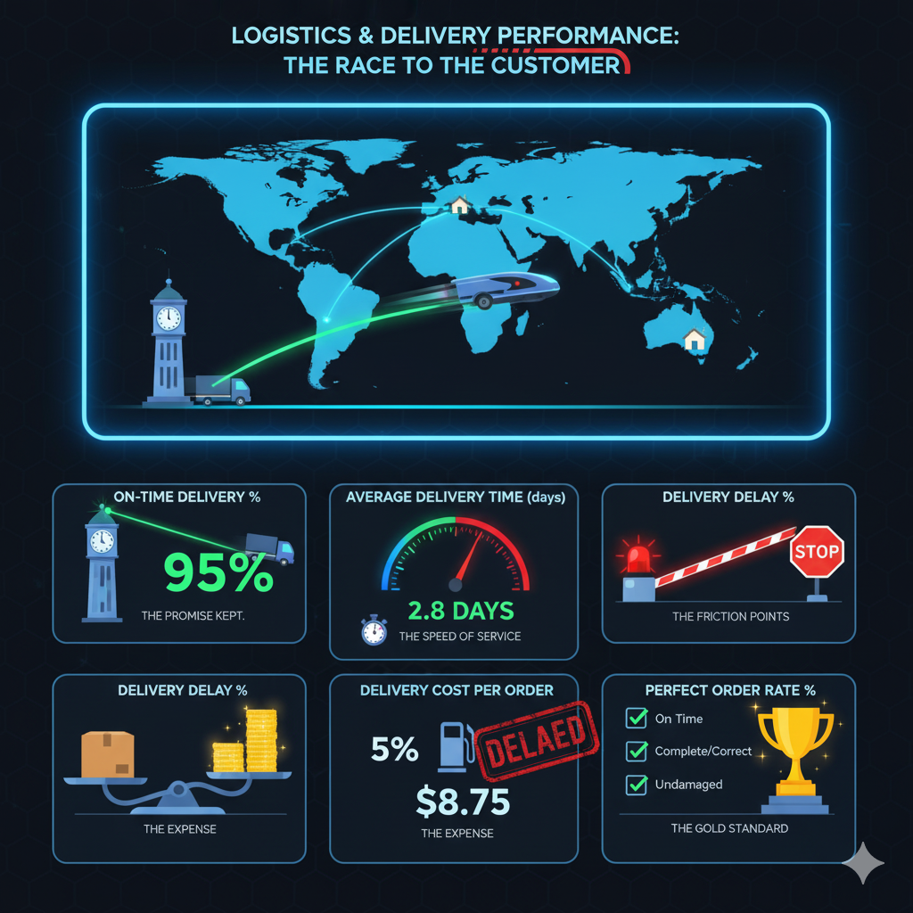
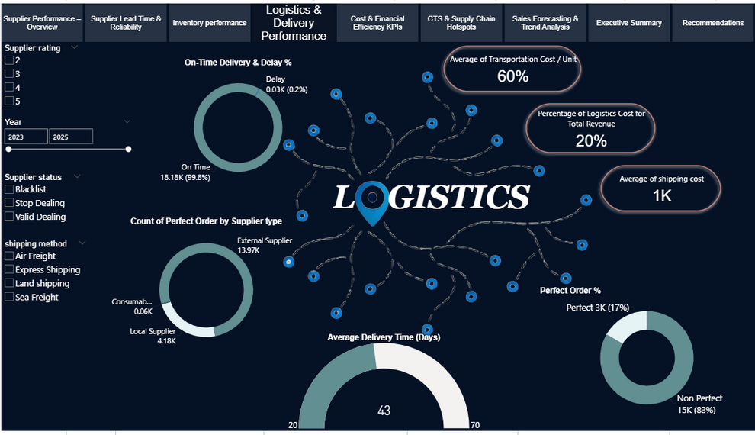
Home
About
Contact
Logistics

Slide 15
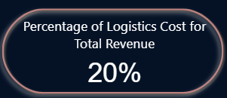
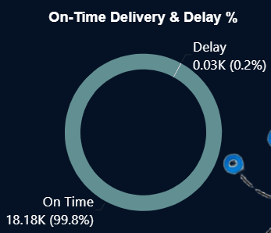
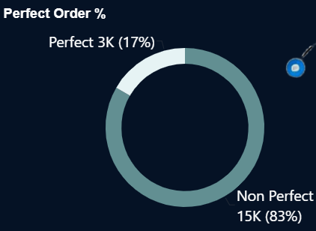
Summary
For the period of 2023 to 2025, logistics operations achieved almost flawless execution in terms of scheduling, with a 99.8% On-Time Delivery Rate. The logistics system is highly cost-efficient, with average logistics costs representing a small percentage 20% of total revenue.
However, operational friction exists in fulfillment accuracy. While items arrive on time, the Perfect Order Percentage is only 17%. This low score is driven almost entirely by minor discrepancies in quantity (short shipments) and small defect/return rates present in nearly every order, rather than major logistics failures.

Slide 16
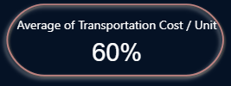
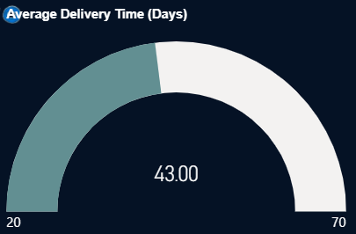
Analysis
The "Perfect Order" Gap:
Despite 99.8% on-time performance, the Perfect Order Percentage 17% reveals a hidden quality control issue.
The data shows that 83.38% of orders fail this metric not because they are late, but because of minor Short Shipments (Added Qty < Ordered Qty) and Defects/Returns.
Almost every shipment has a small discrepancy (e.g., ordering 1,243 units and receiving 1,242), preventing it from being classified as "Perfect."
Delivery Speed vs. Reliability:
The Average Delivery Time is ~43 days, which is standard for international supply chains involving manufacturing lead times. The critical insight is the zero variance; every single order arrived within its designated lead time. This predictability is a massive asset for inventory planning, allowing for precise Just-In-Time (JIT) strategies.
Logistics Efficiency & Cost:
The supply chain is exceptionally lean. The Average Transportation Cost per Unit is 60%, and total logistics costs consume less than 0.01% of Total Revenue. This suggests that the shipping methods utilized (likely a mix of bulk sea freight and land transport) are highly economical relative to the high value of the goods.

Slide 17


Recommendations
Shift Focus from Logistics to QA:
Since delivery timing is almost perfect, management attention should pivot to Vendor Compliance. Investigate why nearly every shipment has minor quantity shortages or defects. Implementing a stricter "In-Full" policy with suppliers could raise the Perfect Order Rate significantly.
Inventory Optimization:
With 0.2% delay risk, one can aggressively reduce safety stock levels for the 2025–2026 forecast period. The reliability of the 43-day cycle allows for tighter capital management without risking stockouts.
Cost Re-investment:
The logistics cost 20% is low, but it implies one could have room to spend abit. If faster lead times are needed (e.g., reducing the 43-day cycle), one can afford to upgrade some shipments to Express or Air Freight without materially impacting profit margins.

Slide 18
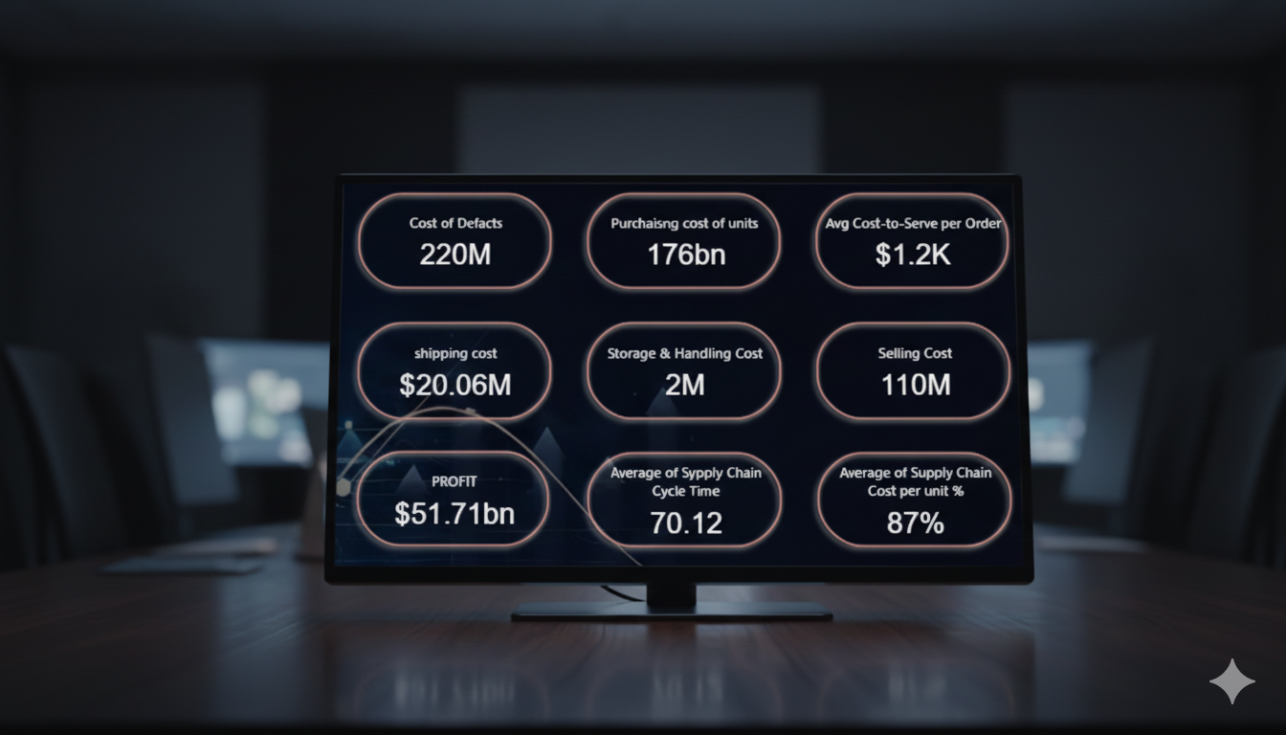
Costs Overview
The main cost drivers in the supply chain and their direct impact on margin.
Top KPIs to reference: PROFIT $51.71bn; Cost of Defects $220M; Shipping Cost $20.06M; Supply Chain Cost = 12% of Revenue; 21% of Total Cost.
Cost lines:
Cost of Defects: $220M — direct margin leak and customer‑experience risk.
Procurement cost per unit: $1.2K.
Shipping cost: $20.06M.
Storage & Handling: $2.2M.
Selling cost: $110M.

Slide 19
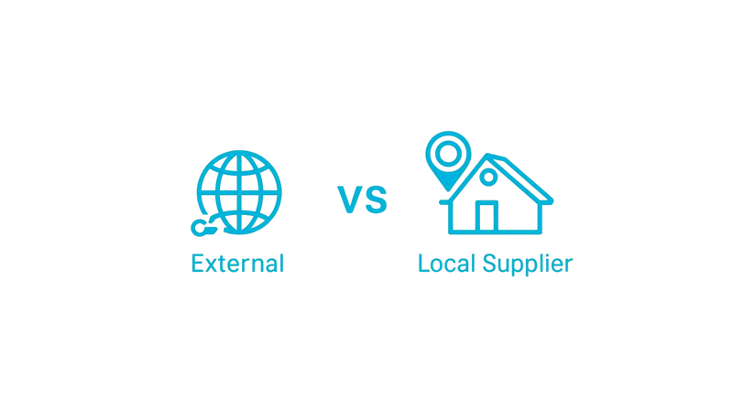
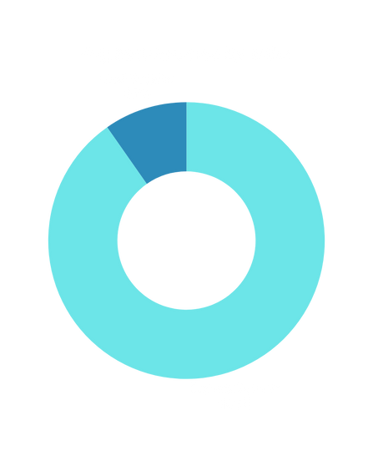

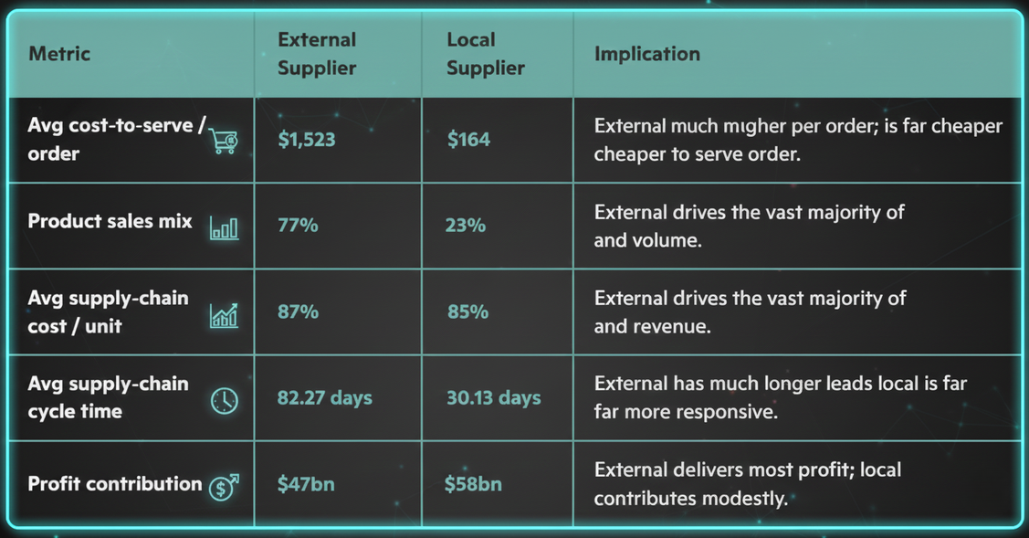
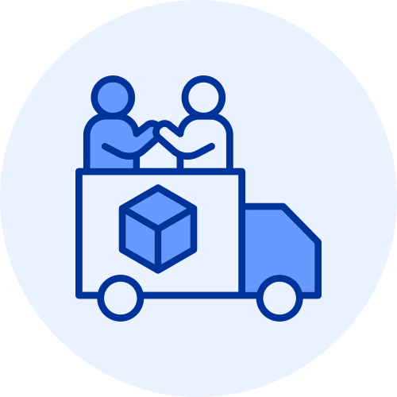
Supplier Performance and Efficiency Overview
insights
Scale and concentration: External suppliers deliver the bulk of sales and profit, creating strong dependence on a smaller set of suppliers.
Cost and service trade‑offs: Although external suppliers show slightly higher cost per unit, their per‑order cost is much higher and cycle times are substantially longer, which increases working capital and risk exposure.
Local supplier value: Local suppliers offer dramatically faster cycle times and much lower cost‑to‑serve per order, making them attractive for high‑service SKUs, emergency replenishment, or risk mitigation despite lower volume and profit today.

Slide 20

Home
About
Contact
Recommendations
conclusion:
is strong at $51.71bn, but defects and shipping are the largest controllable drains on margin.
External suppliers drive most sales and profit, creating concentration risk that should be managed.
recommendations:
Reduce defect costs through targeted quality programs and supplier audits.
Negotiate and consolidate shipping to lower freight spend.
Rebalance supplier mix to reduce concentration risk while protecting margins.
90‑day action plan:
Conduct root‑cause analysis on defects and implement three measurable corrective actions.
Pilot shipping consolidation on top lanes and measure cost impact.
Run a small trial with an alternative local supplier for one product family.

Slide 21
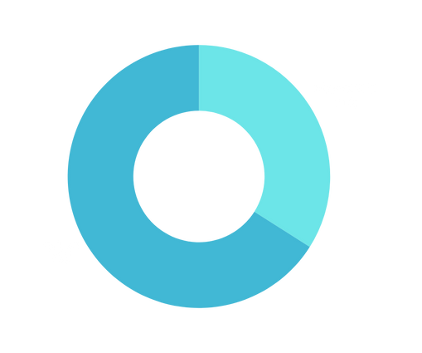


Executive Overview & Purpose
"CTS & Supply Chain Hotspots" section gives a clear, at-a-glance view of cost-to-serve (CTS) performance across the entire supply chain. It highlights a potential pain point that may cause a significant impact on the revenue stream; it also raise a room for improvement later on in the foreseeable future of the supply chain performance.
Revenue Breakdown (SCCPU Oreinted)
High SCCPU contributes 34.2% of total revenue of supply chain
85.99% of
CTS Performance
85.99% of revenue generated is above CTS threshold, indicating strong operational concern!
Data Range
Analysis spans 2023-2025 with filterable slicers for supplier ratings, supplier types, and product categories
26 Product Categories tracked with individual cost-to-serve analysis

Slide 22







Cost-to-Serve Analysis by Product Type
The dashboard reveals significant variation in cost-to-serve efficiency across 26 product types, with clear cost optimization opportunities identified.
Interactive Capability Users can filter by individual product type to isolate cost drivers and supplier performance for specific categories.
Highest CTS Products
Most Efficient Products
Highest SCCPU
Stainless Handrails
$118/order
Packaging
$131 /order
Industrial/basic items show lower operational complexity in terms of cost

Slide 23
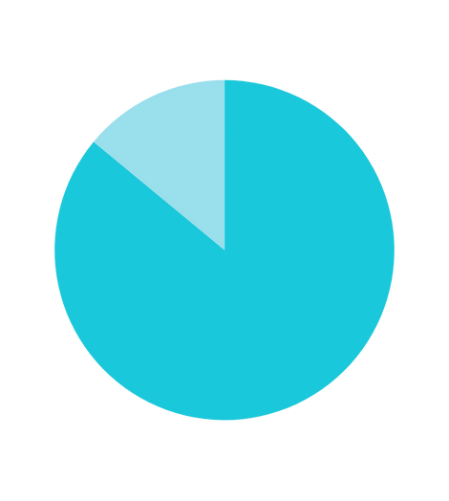


Supplier Type Analysis - External vs. Local Suppliers
SUPPLIER PERFORMANCE & REVENUE IMPACT MATRIX
(Based on CTS Performance & Supplier Type Differences)
Above CTS |  | Below CTS
avg cost ex : TV Stands : $1,900 Kitchens&Accessories: $2,046 | External Suppliers | lower variability
variable cost by product category | Local Suppliers | higher cost pressure ex : Packaging : $3,149
Include as a filter option | Consumables Suppliers | Include in CTS segmentation
Revenue Distribution & CTS performance
Revenue Above CTS: $1.97T (85.99%)
Revenue Below CTS: $320.3B (14.01%)

Slide 24






What’s Next?!
Actionable Recommendations
Monitor products with supply chain costs exceeding 85% of revenue
Investigate supplier efficiency variance, particularly for high-cost items (TV Stands, Kitchens)
Optimize supplier mix between External and Local suppliers based on cost-to-serve performance
Use year-over-year filtering to identify seasonal cost trends and procurement cycle patterns
Dashboard Interactivity: All visualizations and filters are cross-linked, allowing users to drill down into specific segments while maintaining context across multiple analytical dimensions.

Slide 25
Home
Summary
This Dashboard expects sustainable growth in total sales from 113M in 2025 to 191M in 2030, an increase of 78M, which equals approximately 69.03% growth.
Forecasting methodology: time series analysis combined with the Compound Annual Growth Rate (CAGR) to stabilize the trend.
Strategic implication: decisions taken to increase sales volume did not negatively affect product quality or pricing, reinforcing long-term customer partnership.
Supply chain focus: aligning growth with inventory, demand cycle, forecast accuracy, and supplier compliance.

Slide 26

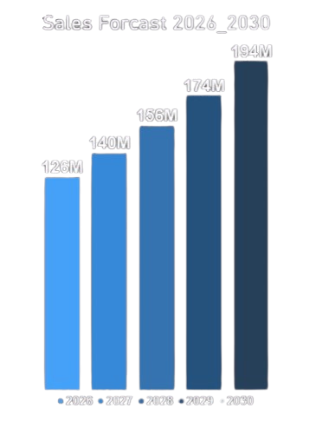
Home
About
Contact
Sales Forecast
expects sustainable growth in total sales from 113M in 2025 to 191M in 2030
an increase of 78M which equals approximately 69.03% growth

Slide 27
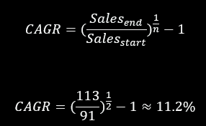
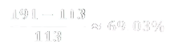

Forecasting Methodology
Time series analysis combined with the Compound Annual Growth Rate (CAGR) to stabilize the trend
Strategic implication: decisions taken to increase sales volume did not negatively affect product quality or pricing, reinforcing long-term customer partnership
CAGR measures the mean annual growth rate over a period longer than one year
Year
Forecasted Sales (M)
2026
126
2027
140
2028
150
2029
174
2030
191

Slide 28

DAX in Forecasting & Implecations
To ensure accuracy and transparency in the forecasting process, we implemented DAX (Data Analysis Expressions) within Power BI.
Purpose: DAX was used to calculate the Compound Annual Growth Rate (CAGR) and to generate independent forecast columns for each year (2026–2030).
Advantage: This approach avoids circular dependencies, ensures stability across different filters, and provides a scientific basis for the forecast.
Outcome: The DAX-driven forecast demonstrates that sales are expected to grow by approximately 69% between 2025 and 2030, while maintaining product quality and price stability.
Quality assurance: Batch-level quality checks and automated inspections at inbound points.
Price stability: Long-term supplier contracts with cost-control clauses.
Customer partnership: Shared dashboards and quarterly reviews to align demand and supply.
Operational readiness: Adjust production and logistics capacity for 2029–2030 demand surge.

Slide 29
Home
Conclusion
Align production and distribution capacity with forecasted demand.
Establish monthly governance for forecast accuracy.
Build Power BI dashboards linking forecasts with supply chain KPIs.
Share demand forecasts with key customers to strengthen trust and collaboration.
The 5-year growth outlook is strong, with a 69% increase projected by 2030.
Forecasting is based on a scientific time series methodology, supported by DAX implementation in Power BI.
Decisions to expand sales volume are balanced with quality and price stability, reinforcing customer partnership.

Slide 30

Home
About
Contact
Recommendations & Conclusion
1. Optimize Stock Coverage
Reduce Stock Coverage Period from 15 months to be within best practice period of 6-12 months.
2. Improve Supplier Performance
Focus on suppliers with lead times >70 days for renegotiation or replacement.
Enhance the supplier rating system to include delivery reliability and defect rates.
3. Enhance Order Accuracy & Delivery
Invest in order fulfillment automation to increase the Perfect Order Rate.
Investigate Actual Delivery Date to ensure adherence to standard according to each insdustrial code.
4. Reduce Supply Chain Costs
Analyse and optimize shipping, storage, and handling costs, which contribute significantly to the 86.79% cost per unit.
Consolidate shipments and renegotiate carrier contracts.
5. Improve Forecasting & Sales Alignment
Align sales forecasts with actuals using AI-based forecasting tools.
Review and adjust CAGR assumptions to reflect realistic growth.
6. Strengthen Data & Reporting
Track dead stock percentage and inventory turnover regularly.
Introduce real-time dashboards for key metrics like lead time, defect rate, and perfect order %.
01
02
03

Slide 31







Home
About
Contact
Meet Our Team
Amr Gamal
Doha Elshewemy
Mohamed Bahgat
Hassan Helmy
Mohamed Sherief
Ahmed Magdy
Suppliers Performance
Inventory Performance
Logistics
Financial Efficiency
HotSpots
Sales Forecast

Slide 32

Home
About
Contact
Thank You
01
ANY QUESTIONS?
02
03
2025 Presentation

